Slide 1




Hexaware CODE&RISE PROGRAM
GIAFusion_Anand_Inst
Fusing Ideas,shaping Futures

Slide 2
Team Details
Team Name : GIAFusion_Anand_Inst
Application Name : Smart Recruiting Platform
Team Members
Email ID
Induja .S
indujasekar2010@gmail.com
Gayathri .B
gayathribaskaran1707@gmail.com
Abinaya .M
abinayam539@gmail.com
Abinaya .R
abi371461@gmail.com

Slide 3

Impact/Potential Value of the Application
1.Streamlined Recruitment Process:
Automates user management and job postings, reducing administrative burden and increasing efficiency.
2.Enhanced Security:
Role-based access control ensures that only authorized users can perform specific actions, protecting sensitive data.
3.Improved Candidate Experience:
Real-time access to job listings allows candidates to quickly find and apply for relevant positions, enhancing user satisfaction.
4.Operational Efficiency:
Centralized management of users and job postings simplifies the recruitment workflow, allowing HR Managers to focus on strategic tasks.
5.Scalable Solution:
The platform can easily adapt to growing numbers of users and job postings, supporting organizational growth.

Slide 4
The Solution Proposed by your Team
Solution Highlights
Key Features / Approach
Automated User Management: Handles sign-ups, logins, and role-specific access.
Efficient Job Posting: HR Managers create and publish job posts with detailed information.
Role-Based Access: Limits features based on user roles (Admin, HR Manager, Candidate).
Real-Time Job Listings: Candidates can view published jobs instantly.
User Management: Streamlined for Admins, HR Managers, and Candidates.
Job Posting: Detailed job creation with options to save as draft or publish.
Access Control: Secure, role-based feature access.
Dynamic Listings: Only published jobs are visible to candidates.

Slide 5
Technologies Used
1. Backend:
Python Classes: Manages users, jobs, and the overall platform.
Data Handling: Uses object-oriented principles for storing and managing user and job data.
2. User Roles:
Admin: Manages user data and access.
HR Manager: Creates and manages job postings.
Candidate: Views job postings and applies.

Slide 6
Gen AI Tool Utilization
1.Automated Candidate Profiling:
AI-driven analysis to match candidates with job postings based on their qualifications and skills.
2.Intelligent Job Recommendations:
Uses machine learning to suggest jobs to candidates based on their profiles and past applications.
3.Natural Language Processing (NLP):
Analyzes job descriptions and candidate resumes to identify the best matches.
4.Real-Time Feedback Analysis:
Implements AI to assess candidate feedback and improve the recruitment process.
5.Predictive Analytics:
Predicts candidate success rates for specific roles, helping HR Managers make informed decisions.

Slide 7
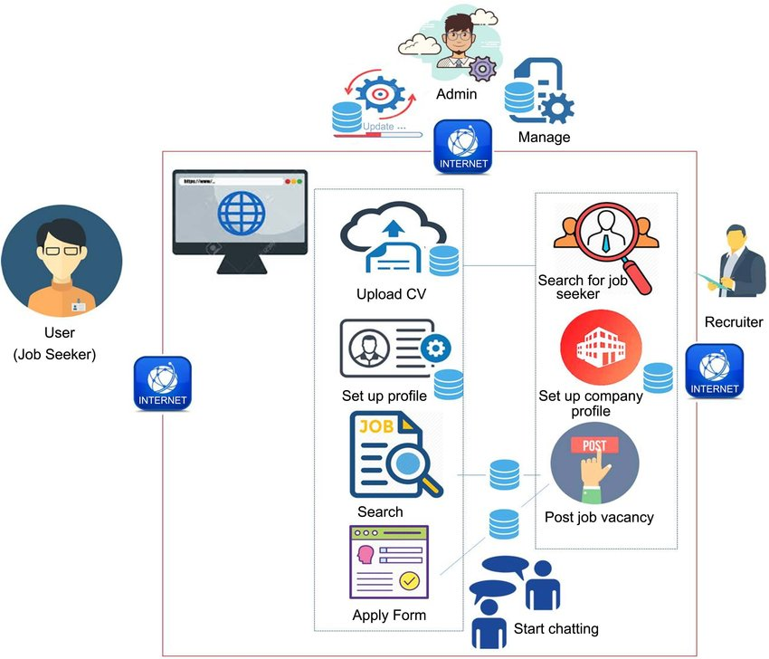
System Architecture, Functionalities and Design Diagram
1.Data Flow & Processing:
Candidate Data Ingestion: Data is collected from application forms and external sources.
AI-Driven Analysis: Data is processed using machine learning models for profiling and matchmaking.
Data Flow & Processing:
Real-Time Updates: Candidates' progress and feedback are tracked and updated in real-time.
2.Components & Interactions:
Frontend: React.js handles user interactions and displays dynamic content.
Backend: Node.js manages API requests and database interactions.
Database: MySQL stores candidate data and feedback securely.
AI Engine: TensorFlow and Scikit-learn perform data analysis and predictions.
3.Data Pipeline, API & External Services:
Data Pipeline: Python scripts process and clean data before feeding it into AI models.
API: RESTful services built with Node.js handle data retrieval, updates, and communication between components.
External Services: AWS S3 for cloud storage and Docker/Kubernetes for deployment and scaling.
Design Diagram:

Slide 8
How it works
User Interaction:
Users (Admin, HR Manager, Candidate) interact through a command-line interface (CLI), where they can sign up, log in, and manage job postings.
Role-Based Access:
Admin: Manages user accounts and can view all users.
HR Manager: Creates, edits, and publishes job postings.
Candidate: Views published job listings and applies.
Data Management:
User and job data are stored in memory during the session, allowing for quick access and processing of user actions.
Job Posting Workflow:
HR Managers create job posts with details like title, description, and qualifications. Jobs can be saved as drafts or published for candidates to view.
Security and Access Control:
The platform enforces role-based access, ensuring that users can only perform actions allowed by their role.

Slide 9
How It Works
Technical Architecture
Python Classes: Core functionality is built using classes for User and Job management.
Command-Line Interface (CLI): Simple CLI for user interaction and navigation.
Role-Based Access: Controls access to features based on user roles (Admin, HR Manager, Candidate)
In-Memory Data: User and job data are stored in memory for quick processing during the session.
Scalability: Designed for simplicity; future versions could integrate a database for persistent storage.

Slide 10
Innovation and Creativity
Role-Based Access Control: Ensures that users can only access features relevant to their roles, enhancing security and usability.
Status Management: Jobs can be saved as drafts or published, allowing HR Managers to control the visibility of job postings.

Slide 11
Scalability, Performance and Security
Scalability: Designed to handle multiple users and job postings, ensuring that the platform can grow with the organization.
Performance: Efficient management of job postings and user roles using Python classes.
Security: Role-based access ensures that sensitive data is only accessible to authorized users.

Slide 12
Best practices and industry standards followed
Object-Oriented Programming (OOP): Utilized OOP principles to ensure modular, reusable, and maintainable code.
Role-Based Access Control: Implemented secure access controls to manage user permissions based on roles (Admin, HR Manager, Candidate).
Data Validation: Ensured proper input validation during user sign-up and job creation processes.
Code Readability: Followed Python's PEP 8 standards for clear and consistent code formatting.
User-Centric Design: Designed with a focus on simplicity and usability via the command-line interface.

Slide 13
User Experience
Simple Navigation:
A user-friendly command-line interface (CLI) allows for easy navigation through the platform's features.
Personalized Experience:
Role-based access ensures users only see options relevant to their role (Admin, HR Manager, Candidate).
Efficient Job Management:
HR Managers can quickly create, edit, and publish job postings with all necessary details.
Instant Access to Job Listings:
Candidates have real-time access to published job postings, making it easy to browse and apply.
Secure and Seamless Interaction:
The platform provides a secure environment for managing sensitive data with role-based permissions and input validation.

Slide 14
Console Output Details
GitHub Repository: https://github.com/Induja2010/Smart-Recruiting-Platform.git
This repository contains all the source code, files, and demo videos related to the Smart Recruiting Platform application.
Working Prototype: The repository includes a working prototype of the Smart Recruiting Platform, showcasing its functionalities.
Video Demo: The video demo files are available within the repository to illustrate the application's working in a live environment.

Slide 15
Thank You

